Slide 1
Context and Spatial Layout
04/26/11
Computer Vision
CS 543 / ECE 549
University of Illinois
Derek Hoiem

Slide 2
Final projects
See class web page for details
Poster session: May 10, 10:30-1pm
Will send out general invite
Each person presents for ~1 hour, then look at other half of posters and review two
Paper: 4-8 pages (NIPS format)
Turn in at poster session or at my office by May 11 noon
Cannot accept late papers (or posters)

Slide 3
Today’s class: Context and 3D Scenes
Continuing advanced topics theme…
Goal is to give a broad overview of current research topics

Slide 4
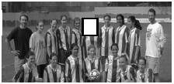
Context in Recognition
Objects usually are surrounded by a scene that can provide context in the form of nearby objects, surfaces, scene category, geometry, etc.

Slide 5

Context provides clues for function
What is this?
These examples from Antonio Torralba

Slide 6

Context provides clues for function
What is this?
Now can you tell?

Slide 7
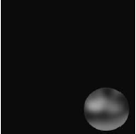
Sometimes context is the major component of recognition
What is this?

Slide 8

Sometimes context is the major component of recognition
What is this?
Now can you tell?

Slide 9

More Low-Res
What are these blobs?

Slide 10
More Low-Res
The same pixels! (a car)

Slide 11
There are many types of context
Local pixels
window, surround, image neighborhood, object boundary/shape, global image statistics
2D Scene Gist
global image statistics
3D Geometric
3D scene layout, support surface, surface orientations, occlusions, contact points, etc.
Semantic
event/activity depicted, scene category, objects present in the scene and their spatial extents, keywords
Photogrammetric
camera height orientation, focal length, lens distorition, radiometric, response function
Illumination
sun direction, sky color, cloud cover, shadow contrast, etc.
Geographic
GPS location, terrain type, land use category, elevation, population density, etc.
Temporal
nearby frames of video, photos taken at similar times, videos of similar scenes, time of capture
Cultural
photographer bias, dataset selection bias, visual cliches, etc.
from Divvala et al. CVPR 2009

Slide 12

Cultural context
Jason Salavon: http://salavon.com/SpecialMoments/Newlyweds.shtml

Slide 13
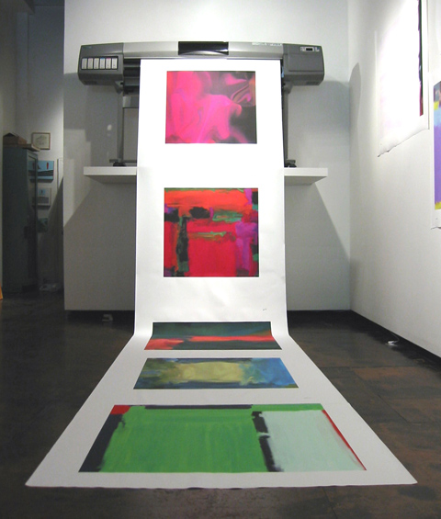

Side note: passes Turing Test for abstract painting?
Jason Salavon: http://salavon.com/Golem/Golem_Table.shtml

Slide 14
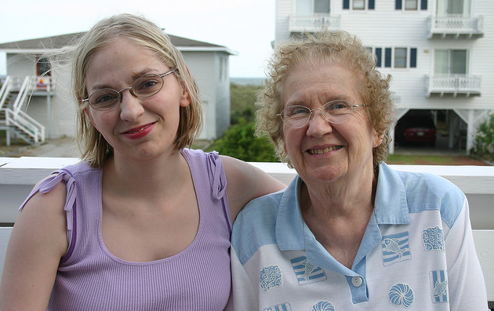
Cultural context
Who is Mildred? Who is Lisa?
Andrew Gallagher: http://chenlab.ece.cornell.edu/people/Andy/projectpage_names.html

Slide 15
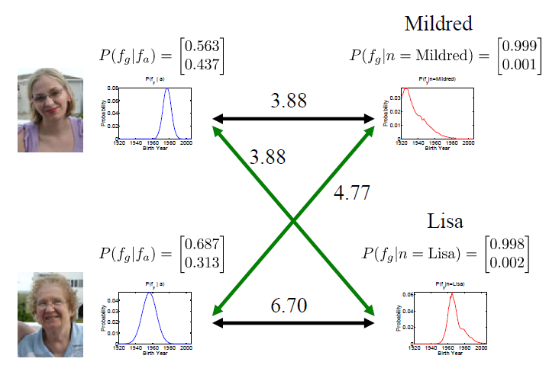
Cultural context
Age given Appearance
Age given Name
Andrew Gallagher: http://chenlab.ece.cornell.edu/people/Andy/projectpage_names.html

Slide 16




Spatial layout is especially important
Context for recognition

Slide 17
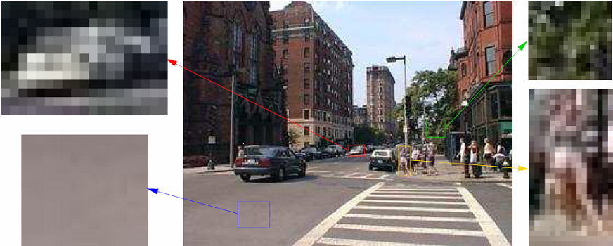
Spatial layout is especially important
Context for recognition

Slide 18
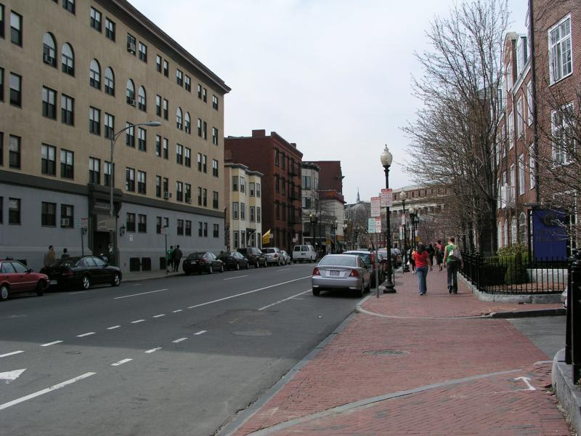
Spatial layout is especially important
Context for recognition
Scene understanding

Slide 19
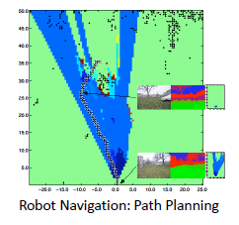

Spatial layout is especially important
Context for recognition
Scene understanding
Many direct applications
Assisted driving
Robot navigation/interaction
2D to 3D conversion for 3D TV
Object insertion

Slide 20
Spatial Layout: 2D vs. 3D

Slide 21
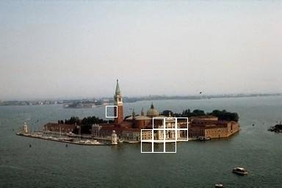
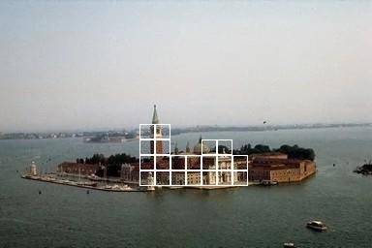
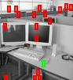


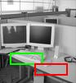
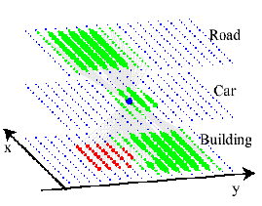

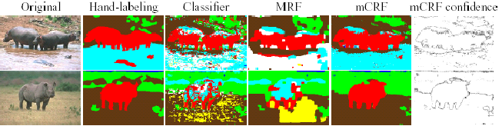
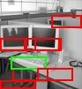

Context in Image Space
[Torralba Murphy Freeman 2004]
[Kumar Hebert 2005]
[He Zemel Cerreira-Perpiñán 2004]

Slide 22
But object relations are in 3D…
Close
Not Close
Notes:
Clearly, image understanding is a 3D problem.

Slide 23
How to represent scene space?

Slide 24
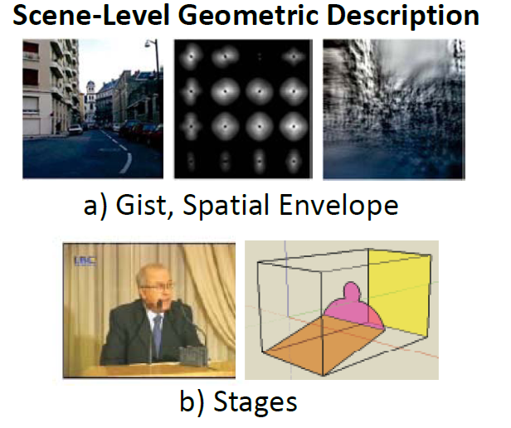
Wide variety of possible representations
Figs from Hoiem/Savarese Draft

Slide 25
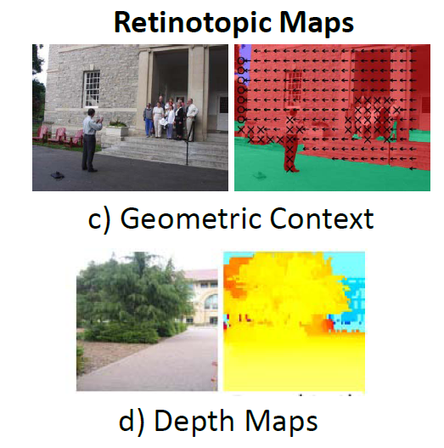
Figs from Hoiem/Savarese Draft

Slide 26
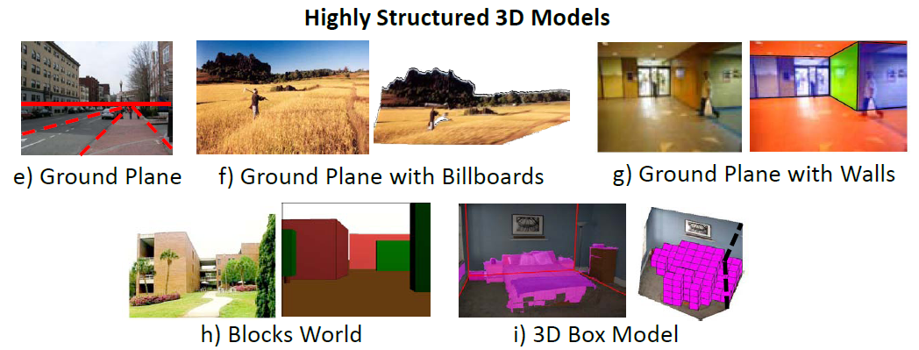
Figs from Hoiem/Savarese Draft

Slide 27
Key Trade-offs
Level of detail: rough “gist”, or detailed point cloud?
Precision vs. accuracy
Difficulty of inference
Abstraction: depth at each pixel, or ground planes and walls?
What is it for: e.g., metric reconstruction vs. navigation

Slide 28
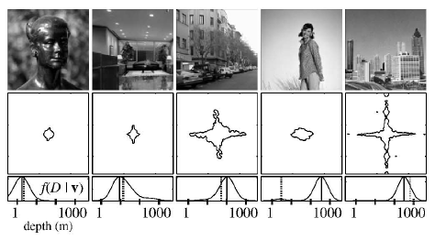
Low detail, Low abstraction
Holistic Scene Space: “Gist”
Torralba & Oliva 2002
Oliva & Torralba 2001

Slide 29
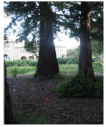
High detail, Low abstraction
Depth Map
Saxena, Chung & Ng 2005, 2007

Slide 30
Medium detail, High abstraction
Room as a Box
Hedau Hoiem Forsyth 2009

Slide 31
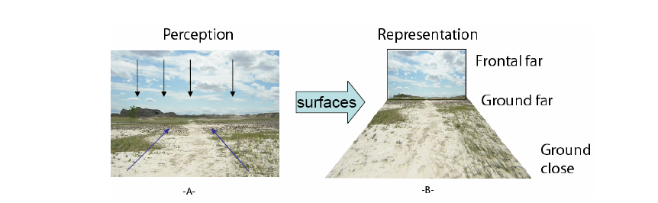
Gibson’s Surface Layout
Gibson: “The elementary impressions of a visual world are those of surface and edge.” The Perception of the Visual World (1950)
Focus on texture gradients
slide from Aude Oliva

Slide 32
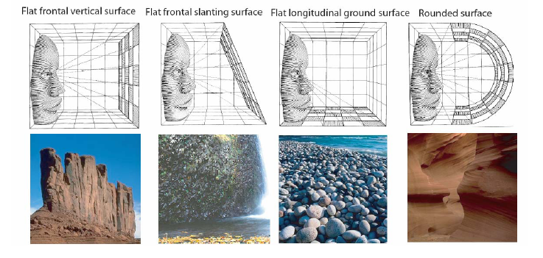
Gibson’s Surface Layout
slide from Aude Oliva

Slide 33
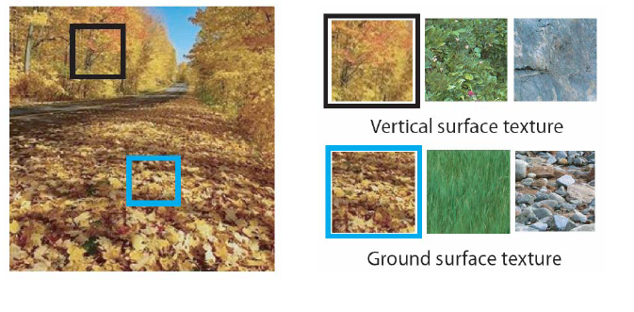
Gibson’s Surface Layout
slide from Aude Oliva

Slide 34
A few examples of spatial layout estimation
Surface layout
The room as a box
Depth estimation

Slide 35







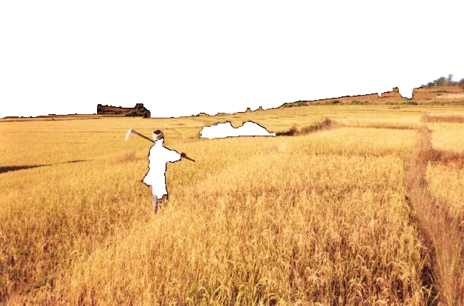
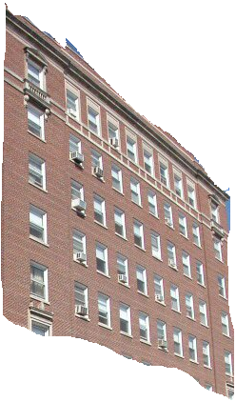

Surface Layout: describe 3D surfaces with geometric classes
Sky
Non-Planar Porous
Vertical
Non-Planar Solid
Planar
(Left/Center/Right)
Support

Slide 36


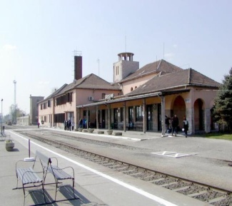


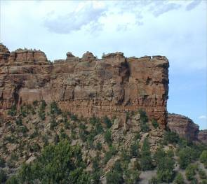
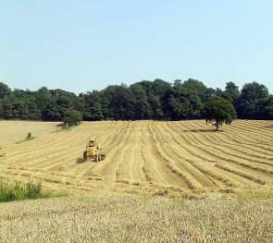

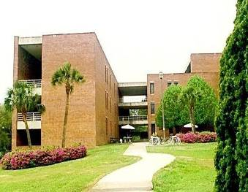

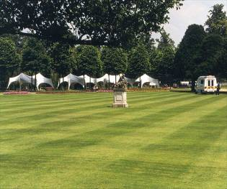
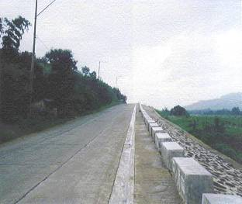
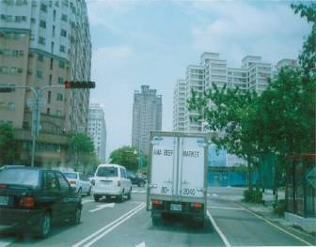


Geometry estimation as recognition
Features
Color
Texture
Perspective
Position
Surface Geometry Classifier
Vertical, Planar
Region
…
Training Data
Notes:
Regions → Surface Orientation Label
Boundaries → Occlusion Labels
Similar Images → Viewpoint

Slide 37
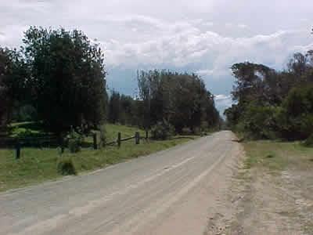
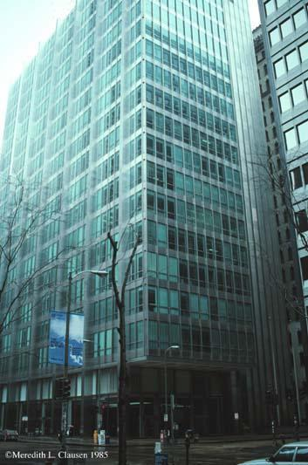

Use a variety of image cues
Color, texture, image location
Vanishing points, lines
Texture gradient

Slide 38

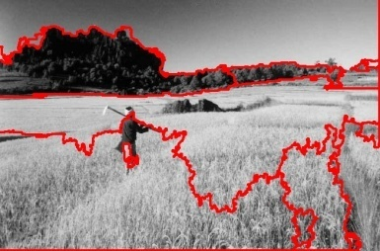
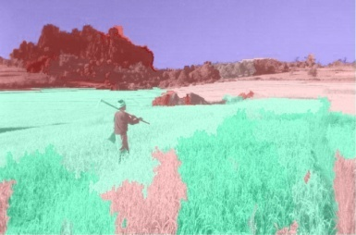
Surface Layout Algorithm
Input Image
Segmentation
Surface Labels
Features
Perspective
Color
Texture
Position
Trained Region Classifier
…
Training Data
Hoiem Efros Hebert (2007)

Slide 39
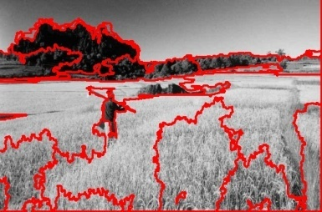
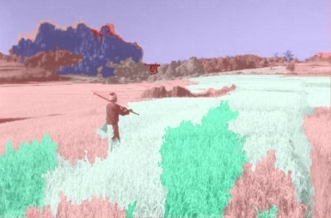
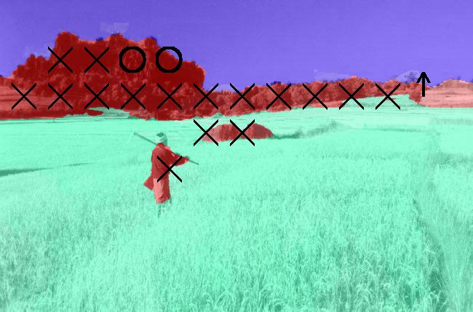

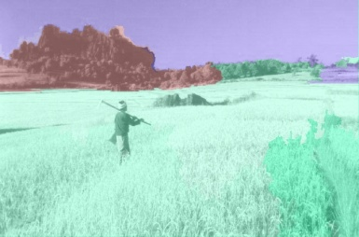
Surface Layout Algorithm
Multiple Segmentations
Confidence-Weighted Predictions
Final
Surface Labels
Input Image
Features
Perspective
Color
Texture
Position
…
…
Trained Region Classifier
Training Data
…
Hoiem Efros Hebert (2007)
Notes:
Specify how estimates are combined. Perhaps show result examples

Slide 40
Surface Description Result

Slide 41

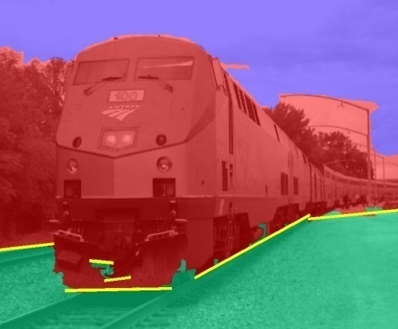

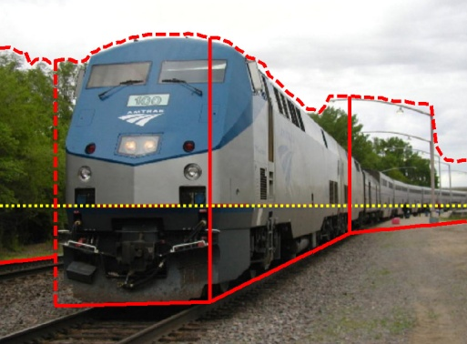
Automatic Photo Popup
Labeled Image
Fit Ground-Vertical Boundary with Line Segments
Form Segments into Polylines
Cut and Fold
Final Pop-up Model
[Hoiem Efros Hebert 2005]
Notes:
Note that horizon estimate is often poor

Slide 42
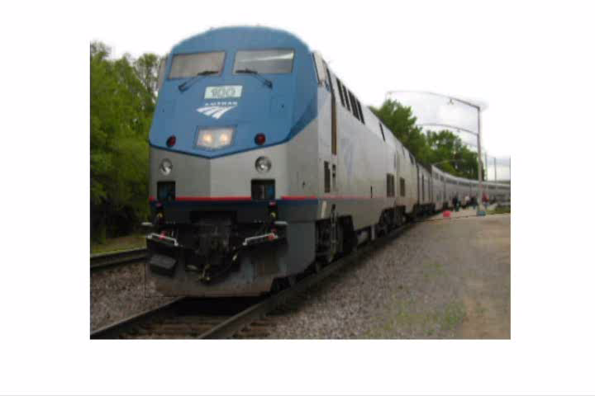
Automatic Photo Pop-up

Slide 43
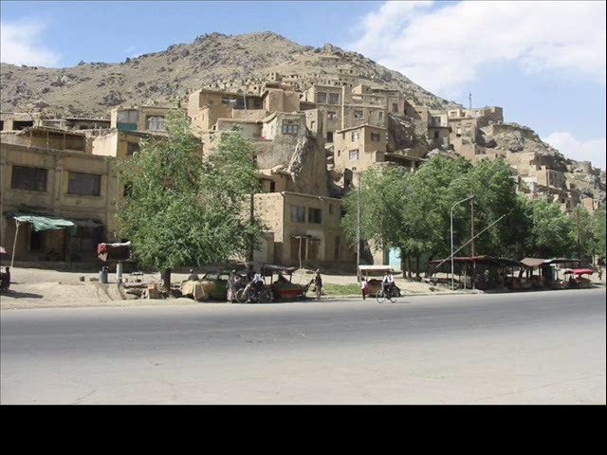
Notes:
Explain holes

Slide 44
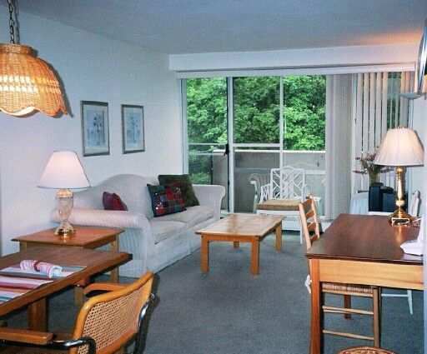
What about more organized but complex spaces?
Other excellent works include:
Saxena Sun Ng (2009)
Lee Kanade Hebert (2009)
Gupta Efros Hebert (2010)

Slide 45
The room as a box
Hedau Hoiem Forsyth (2009)

Slide 46


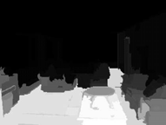
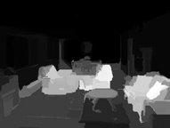
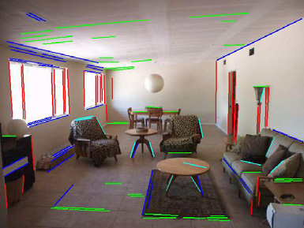
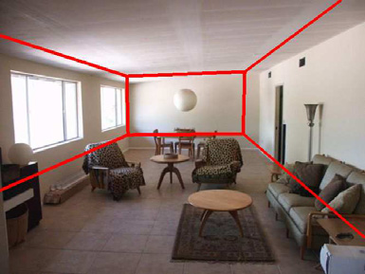
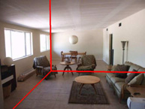



Recovering the box layout
Vertical
VP
Surface Label Confidences
Left Wall
Right Wall
Floor
Objects
Joint Inference
Most Likely Geometry
Detected Edges
+ Vanishing Points
Hypothesized Boxes

Slide 47


Estimate room’s physical space from one image
Estimated “Box” Geometry + Object Pixels
3D Reconstruction + Estimated Occupied Volume

Slide 48


Detecting 3D bed positions in an image
3D Bed Detection with Scene Geometry
2D Bed Detection
Hedau Hoiem Forsyth (2010)
Notes:
Bounding box doesn’t provide a good coordinate system for beds. We can do a better job by accounting for the room orientation and using the spatial context provided by the room.

Slide 49





Searching for beds in room coordinates
Recover Room Coordinates
Rectify Features to Room Coordinates
Rectified Sliding Windows

Slide 50
3D bed detection from an image

Slide 51
Reason about 3D room and bed space
Joint Inference with Priors
Beds close to walls
Beds within room
Consistent bed/wall size
Two objects cannot occupy the same space
Hedau Hoiem Forsyth (2010)

Slide 52

Depth Estimates from an Image
Saxena et al. 2005, 2008

Slide 53

Depth from Image: approach
Divide image into superpixels
Compute features for each superpixel
Position, color, texture, shape
Predict 3D plane parameters for each superpixel using features
Estimate confidence in prediction using features
Global inference, incorporating constraints of connected structure, co-planarity, co-linearity
Saxena et al. 2008

Slide 54
Depth Estimates from an Image
Saxena et al. 2005, 2008

Slide 55

Depth Estimates from an Image
Saxena et al. 2008

Slide 56




Depth from Image: Reconstructions
Input
Novel View
Saxena et al. 2008

Slide 57

Depth from Image
Demo and publications:
http://make3d.cs.cornell.edu/
Autonomous driving (Michels Saxena Ng 2005)

Slide 58
Things to remember
Objects should be interpreted in the context of the surrounding scene
Many types of context to consider
Spatial layout is an important part of scene interpretation, but many open problems
How to represent space?
How to learn and infer spatial models?
Consider trade-offs of detail vs. accuracy and abstraction vs. quantification

Slide 59


Next class: what you can do with lots of images (massively data-driven approaches)
The Big Picture, Birmingham, England

